Slide 1

Risk and Investments
Stock analysis

Slide 2

INTRODUCTION
- The current exam presentation is to illustrate and explain an investment plan based on the evaluation of a stock portfolio consisting of a series of shares from 3 different companies listed on the Bucharest Stock Exchange (BVB).

Slide 3

PORTFOLIO COMPANIES

Slide 4
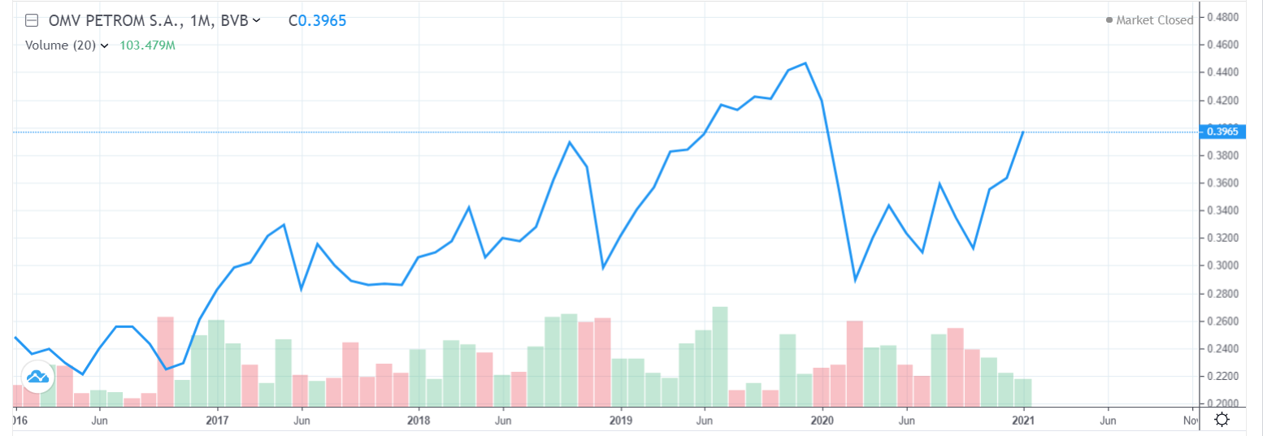
OMV PETROM S.A.
- Financially speaking, the stock prices listen on BVB from the last 5 years depict the fact that from 2016 to 2019, there occurred an ascendant trend in the stock price. From the end of 2019, there was a drastic drop in the stock prices, but from the beginning of 2020 and until now, the prices started to increase.
- Overall, the company presents high opportunities of investment insofar as the stock price volatility is low-medium, there are many ascendant trends, and the external possible threats cannot affect the company’s profit or financial evolution so easily.

Slide 5
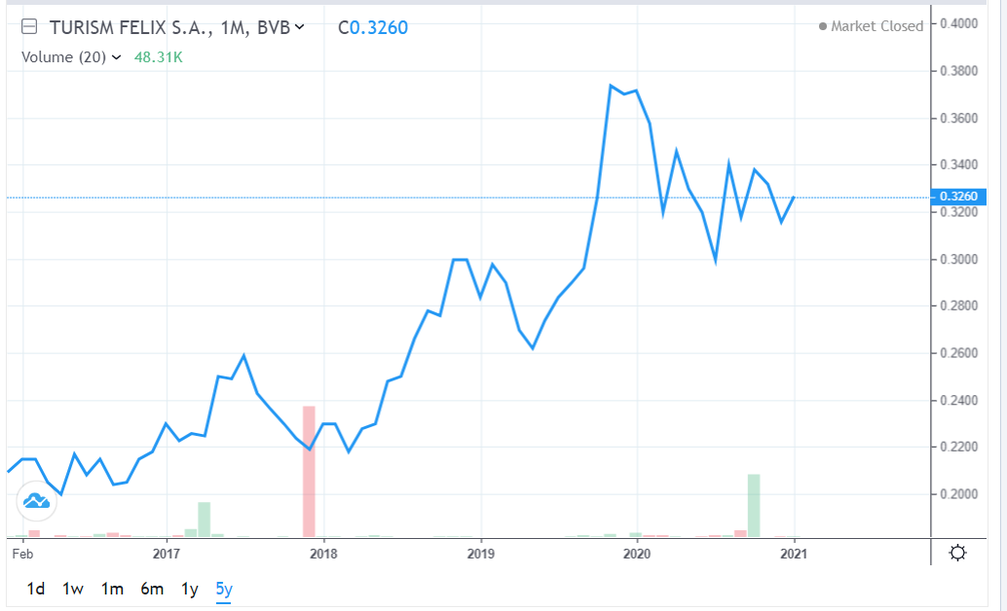
TURISM FELIX S.A.
The BVB shows the fact that in the last 5 years the price trend had been an up one, increasing from year to year.
On rational grounds, the company is to keep its profits at a high level as it is a big player in the industry. It’s a fundamental need for the people that suffer from health issues, and also a big want for the people that want to relax during their spare time.
In the current Pandemics, as the people have been obliged to stay in lockdown, perhaps the investors got alarmed and sold the stocks, creating a small decrease in the stock price.

Slide 6
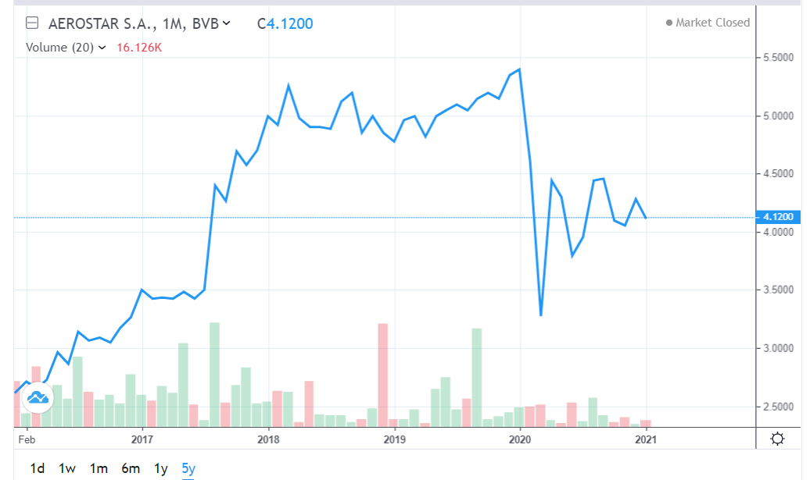
AEROSTAR S.A.
The company operates in the aeronautics industry, producing specific aircrafts, engines, and providing maintenance and it serves worldwide.
From 2016 the company followed an increasing trend in the stock price evolution until 2020.
Due to its supposing many contracts and collaborations with partners throughout the world, the company has high chances of “staying on the ground”.
From the first month of 2020 until the third month of the year, there was a rapid drop of approximately two price units. This happened most probably due to the pandemics as the production stopped, but as it’s being shown the prices are slightly volatile but still low in this period, offering the investors an opportunity at purchasing at a discount

Slide 7
STOCK ANALYSIS
Date (Consecutive Days) | Company 1 (OMV PETROM S.A) | Company 2(TURISM FELIX S.A.) | Company 3 (AEROSTAR S.A. )
25.11.2020 | 0,3580 | 0,3320 | 4,0600
26.11.2020 | 0,3580 | 0,3320 | 4,1400
27.11.2020 | 0,3565 | 0,3180 | 4,1800
2.12.2020 | 0,3570 | 0,3180 | 4,2000
3.12.2020 | 0,3595 | 0,3160 | 4,1800
4.12.2020 | 0,3640 | 0,3300 | 4,2200
7.12.2020 | 0,3600 | 0,3140 | 4,1400
8.12.2020 | 0,3600 | 0,3320 | 4,3000
9.12.2020 | 0,3595 | 0,3140 | 4,2400
10.12.2020 | 0,3595 | 0,3160 | 4,2800
11.12.2020 | 0,3585 | 0,3160 | 4,3000
14.12.2020 | 0,3630 | 0,3160 | 4,2800
15.12.2020 | 0,3630 | 0,3140 | 4,2800
16.12.2020 | 0,3625 | 0,3180 | 4,2600
17.12.2020 | 0,3645 | 0,3200 | 4,2000

Slide 8
PRICE EVOLUTION (SAMPLE)

Slide 9
PRICE EVOLUTION (SAMPLE)

Slide 10
PRICE EVOLUTION (SAMPLE)

Slide 11
MEAN RETURN AND RISK
Mean Return C1 | Mean Return C2 | Mean Return C3 | Risk C1 | Risk C2 | Risk C3
0.3602 | 0.3204 | 4.2173 | 0.00256 | 0.00714 | 0.06964

Slide 12
VARIANCE-COVARIANCE MATRIX
 | Company 1 (OMV PETROM S.A) | Company 2(TURISM FELIX S.A.) | Company 3 (AEROSTAR S.A. )
Company 1 (OMV PETROM S.A) | 0.0000061849 | 0.0000006684 | 0.0000387755
Company 2(TURISM FELIX S.A.) | 0.0000006684 | 0.0000406735 | -0.0000391837
Company 3 (AEROSTAR S.A. ) | 0.0000387755 | -0.0000391837 | 0.0029551020

Slide 13
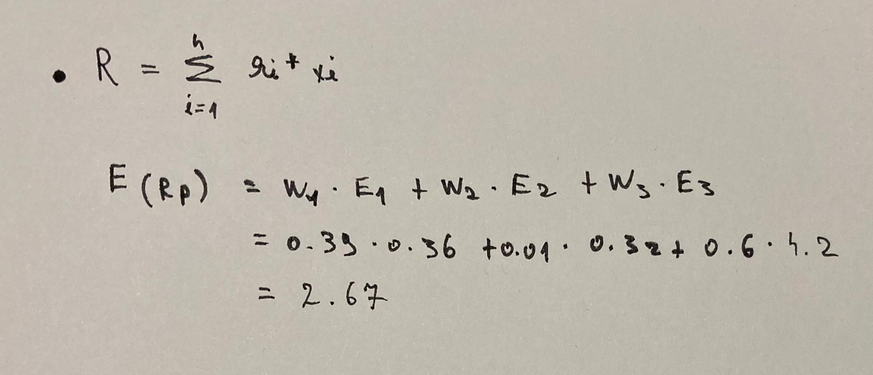
PORTFOLIO RETURN

Slide 14
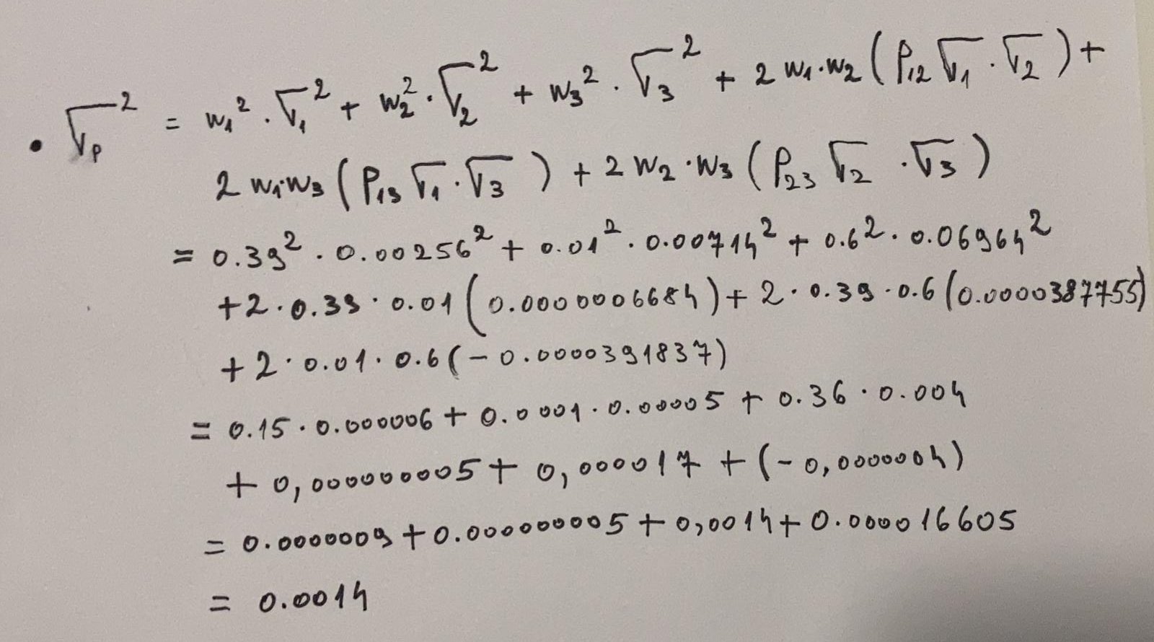
PORTFOLIO RISK

Slide 15
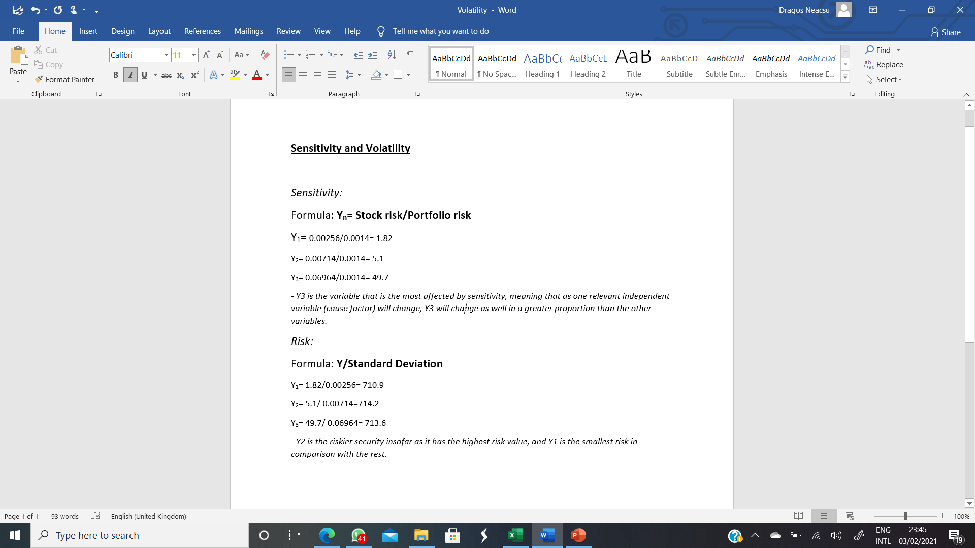
Sensitivity and Volatility

Slide 16
CONCLUSION
The Portfolio Return is 2.67, meaing that there is a 267% return on portfolio.
The Portfolio Risk of 0.0014 due to the well-established weights and low levels of correlation between all the variable relationships, is small.
In conclusion, I am a good investor due to the presented facts.

